Slide 1
Comprehensive digital marketing project work
FLYING MACHINE

Slide 2
Part 1: brand study, competitor analysis & buyer’s/Audience’s prsona

Slide 3

flyingmachine.nnnow.com
Flying Machine is India’s iconic denim brand that is currently one of the coolest youth apparel brands in the country.
The Flying Machine brand is driven to innovate, experiment and push boundaries. Flying Machine India aims to keep up with millennials’ fashion choices and stay on top of the style game, always.
Flying Machine brand chooses to be a trendsetter rather than a fad-follower and this attitude is reflected in each and every one of its products.

Slide 4
MISSION:
Flying Machine’s challenge was to evoke feelings of escapism, heroism and power, and bring out the classic hero in all of us.
Flying Machine aspired to develop an educating, entertaining and inspiring experience across diverse media.
Flying Machine's mission is to inspire and bring out the best in their customers through their fashionable and sustainable clothing offerings.
They also prioritize sustainability and ethical practices in their manufacturing processes to minimize their impact on the environment.

Slide 5
Core values:
Quality: Flying Machine places a strong emphasis on delivering high-quality products. They use the finest materials and employ stringent quality control measures to ensure that their garments are durable, comfortable, and long-lasting.
Innovation: Flying Machine is committed to continuous innovation in design, materials, and manufacturing processes. They strive to stay ahead of emerging fashion trends and bring unique and creative products to their customers.
Customer-centricity: Flying Machine values its customers and places them at the center of everything they do. They focus on providing exceptional customer service, listening to customer feedback, and continuously improving their products and experiences based on customer needs.
Style: Flying Machine is dedicated to creating fashionable and trendy clothing that reflects individual style and self-expression. They aim to empower their customers to look and feel their best, offering fashion-forward designs that cater to diverse tastes and preferences.
Sustainability: Flying Machine is dedicated to reducing their environmental impact and promoting sustainability. They prioritize responsible sourcing of materials, promote recycling and waste reduction, and strive to minimize water and energy consumption in their manufacturing processes.

Slide 6
Unique selling point:
USP also called a unique selling proposition, is a marketing statement statement that differentiates a product or brand from its competitors.
The unique selling point (USP) of Flying Machine lies in its combination of style, quality, and affordability. Here are some key aspects that sets Flying Machine apart from its competitors.
BRAND MESSAGING:
Flying Machine encourages individuals to embrace their uniqueness and express themselves through their clothing choices. They believe that fashion is a powerful form of self-expression and offer a range of trendy and stylish options for customers to create their own distinctive style.
Flying Machine positions itself as a brand that sets trends rather than follows them. They strive to stay ahead of the fashion curve by offering innovative and fashion-forward designs that appeal to those who seek to be at the of style.
TAGLINE:
The tagline of Flying Machine is "Born to Fly."

Slide 7
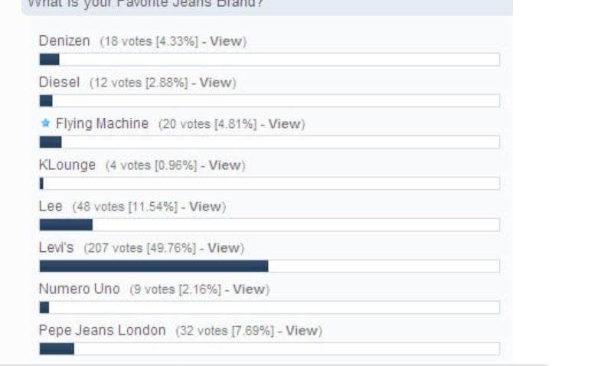
COMPETITORS:
Flying Machine--(Vote 4.81%)-Flying Machine range of apparel reflects the future of Indian Youth fashion that believes in bringing real time international fashion to Indian audience. The brand with its contemporary styling focuses on the trends and fads of the season.
Also, from the price point, Flying machine has been giving its competitors such as Wrangler, Spykar, Levis, & Pepe Jeans a run for their money. Skinny jeans, ripped or distressed jeans, mom fit, boyfriend jeans, straight fit, super skinny fit.

Slide 8
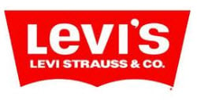
Levi’s- (vote - 49.76%) Levi Strauss and Company (LS&CO) is a privately held clothing company known worldwide for its Levi’s brand of denim jeans. It was founded in 1853 when Levi Strauss came from Buttenheim, Franconia to San Francisco, California to open a west coast branch of his brothers’ New York dry goods business. It is one of the most leading denim brands and can be considered to be he best as the youth of India is crazy about the best fits and affordable prices of Levi’s. Jeans and Levi's are synonymous over the world. A privately owned apparel firm called Levi Strauss and Company (LS&CO) is well-known throughout the world for its Levi's brand of denim jeans.
WEBSITE: https://www.levi.in/

Slide 9

Pepe Jeans London-(Vote 7.69%)- The year is 1973, David Bowie has just released Ziggy Stardust & The Spiders From Mars, ´Slades Cum On Feel The Noize´was blaring out on stereos everywhere, Marlon Brando refuses to accept his Oscar as a protest against the plight of native american indians, Mean Streets, Live And Let Die, Paper Moon and. By 1980 Pepe Jeans London was rivalling all of the big US brands for No.1 spot in the market place, becoming the UKs most succesful jeans brand ever. Over the last 35 years Pepe has continued with maverick photographers, directors and talent and has had the pleasure of watching some of them grow into who they are today.
WEBSITE: https://www.pepejeans.in/

Slide 10

Lee- (Vote - 11.54%)- The company was formed in 1889 by Henry David Lee as the Lee Mercantile Company at Salina, Kansas producing dungarees and jackets. The growth of Lee was prompted by the introduction of the Union-All work jumpsuit in 1913 and their first overall in 1920. Later in the 1920s Lee introduced a zipper fly and continued to expand. Around this time, the first children’s overall line was sold. In 1928 H.D. Lee, founder and president of The H.D. Lee Mercantile Company, died of complications following a heart attack. During the 1930s and 1940s the company became the leading manufacturer of work clothes in the US.
WEBSITE: https://www.lee.in/

Slide 11
BUYERS PERSONA:
Buyers persona is a profile that represents a subgroup of target audience .
User persona are based on real life data and reflect the wants and needs of the audience or users.
We have collected the user persona of a person who is working in IT sector and by this we understood what are the improvements to do for the organization.

Slide 12
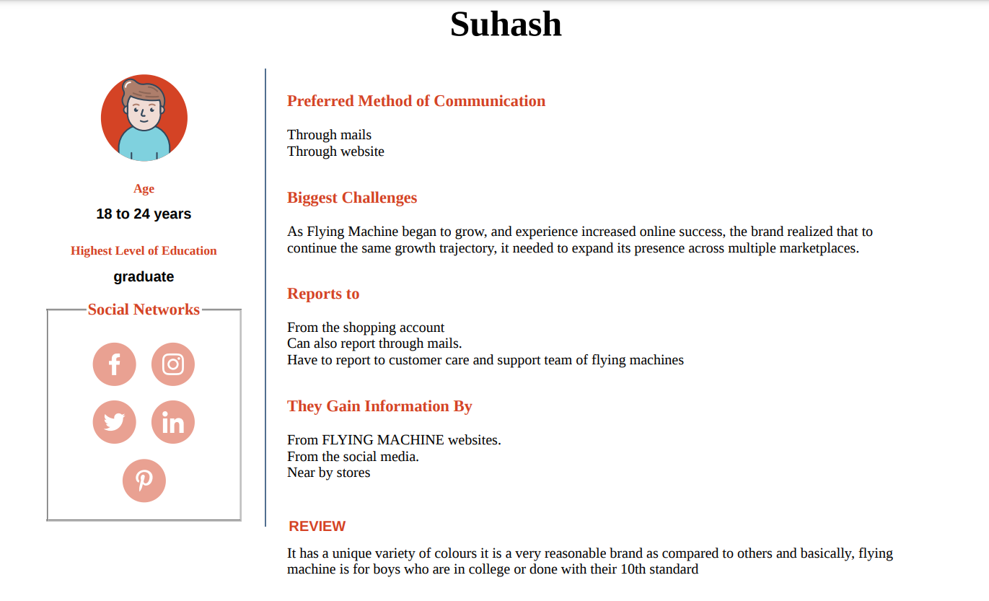

Slide 13
PART 2: SEO & KEYWORD RESEARCH

Slide 14
SEO AUDIT:
An SEO audit is the process of evaluating how well your website is optimized for search engines.
It identifies errors that can prevent your site from ranking well and opportunities that can help you rank better.
An SEO audit usually covers areas like:Indexing and crawlability User experience Site architecture Competitor bench marking Keyword research On-page SEO Backlink profile.
Website: https://flyingmachine.nnnow.com/

Slide 15
KEYWORD RESEARCH:
The Keyword of Flying Machine looks at the key internal factors of its business which gives it competitive advantage in the market and strengthens its position .A list of strengths is mostly the starting point in a “SWOT” analysis. Below are the Strengths in the SWOT Analysis of Flying Machine :
1. Brand has tied up with Italian designers to get an Italian touch to Indian clothing.
2. Owns over 100 stores in India and is present in five countries abroad.
3. Belongs to the prestigious Arvind mills group which extends their brand image.
4. Good advertising and brand building through ad campaigns.
5. Good perception of the brand as a high quality yet affordable product.

Slide 16
Content Creating Ideas and Strategies
PART 3

Slide 17

2023

Slide 18
As shown in the calendar we have reached our intent.
As the part of the content we have prepared few posters and also advertising videos.
Attracting the people towards the fashion totally depends on the way we showed about that particular brand.
Its been a challenge to our team to get thoughts regarding content.
We have explored the different websites for the information about their customers and we heard the reviews of the customer of the flying machine brand.

Slide 19
Part 4: Content Creation and Curation (Post creations, Designs/Video Editing, Ad Campaigns over Social Media and Email Ideation and CreatioN)
PART 4

Slide 20
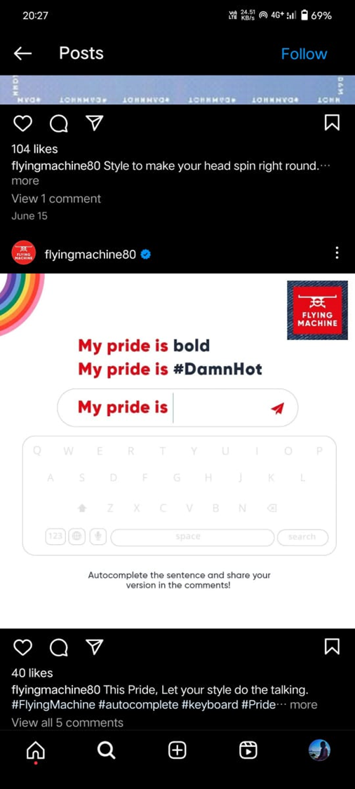
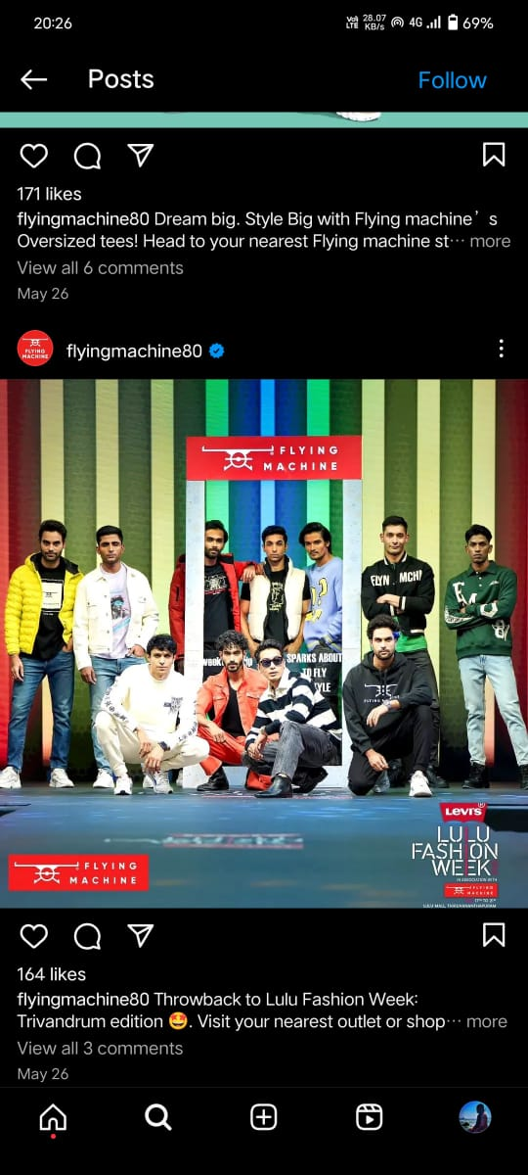
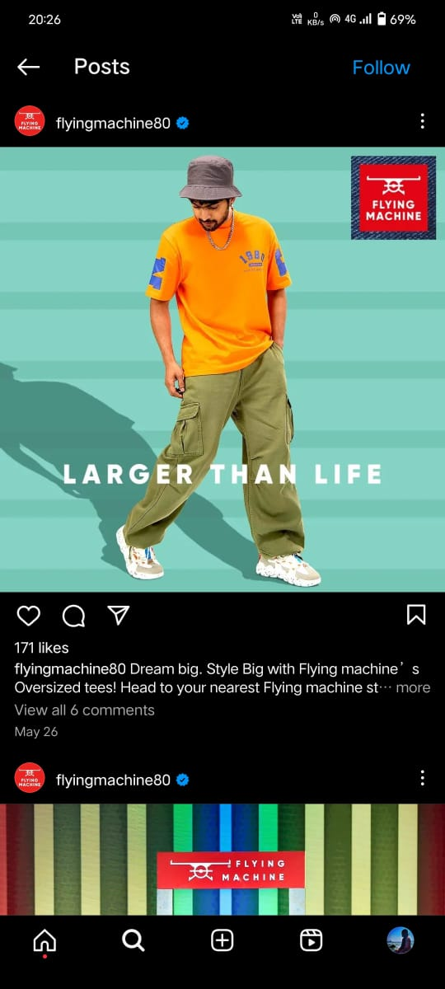
POST CREATION:

Slide 21
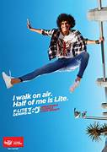
FORMAT 1: BLOG ARTICLE
Aim: Flying Machine aims to bring innovation to the world of fashion by creating unique and trendy designs that set trends rather than follow them. Drawing inspiration from aviation, the brand crafts clothing that stands out with its creativity and originality.
DATE : 20th July 2023
IDEA : To get latest updates from the flying machine
website for the latest fashion.
TOPIC: Adventure-Ready Fashion.

Slide 22

FORMAT 2:VIDEO
AIM: Flying Machine is committed to delivering garments of superior quality and durability. Each piece is crafted with meticulous attention to detail to ensure longevity and lasting comfort.
DATE : 22ND July 2023
IDEA : Awareness of flying machine.
TOPIC: Brand awareness

Slide 23
FORMAT 3:CREATIVE
AIM: The aim of the flying machine cloth brand is to redefine fashion and elevate everyday style to new heights. Inspired by the spirit of aviation and adventure.
DATE : 26th July 2023
IDEA : To attract more customer
TOPIC: Customer satisfaction.

Slide 24
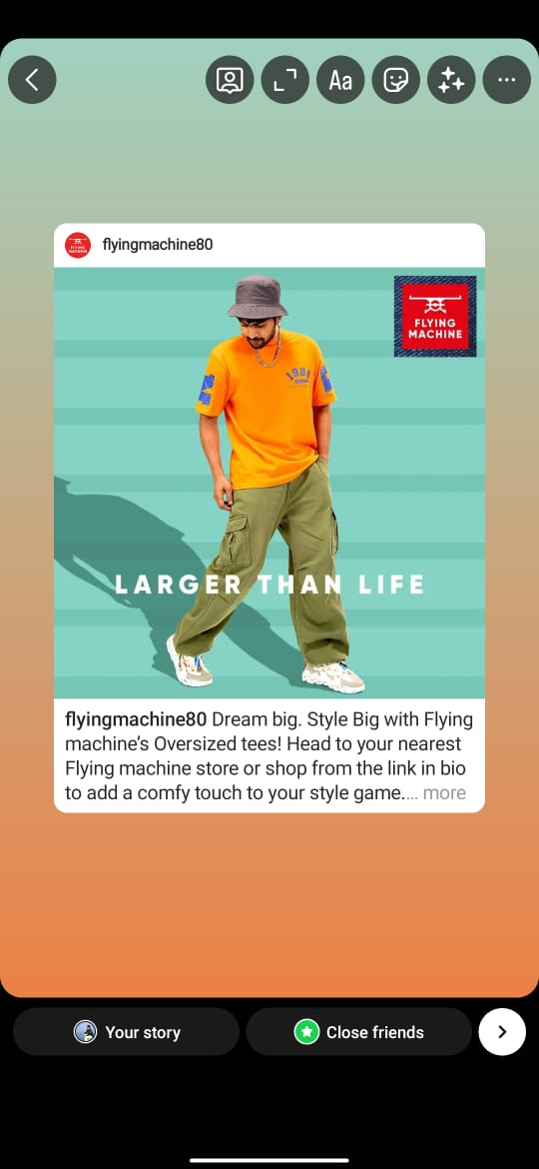
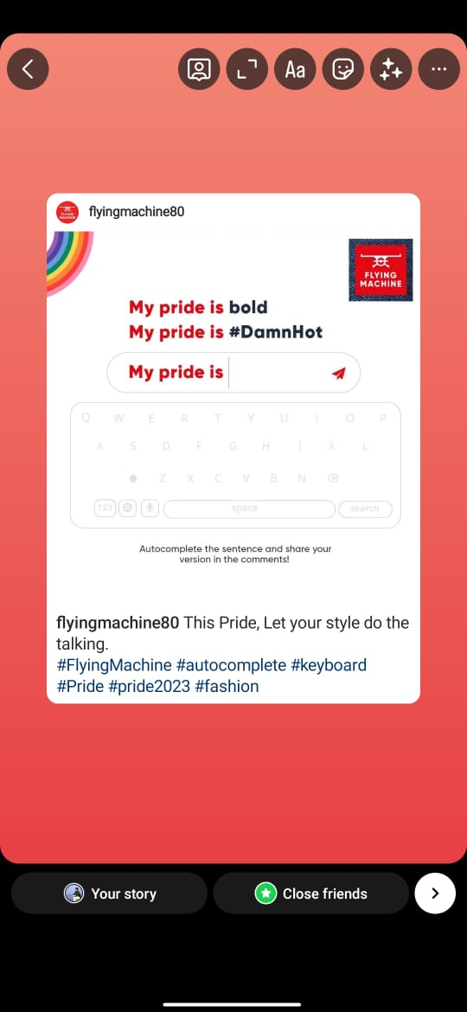
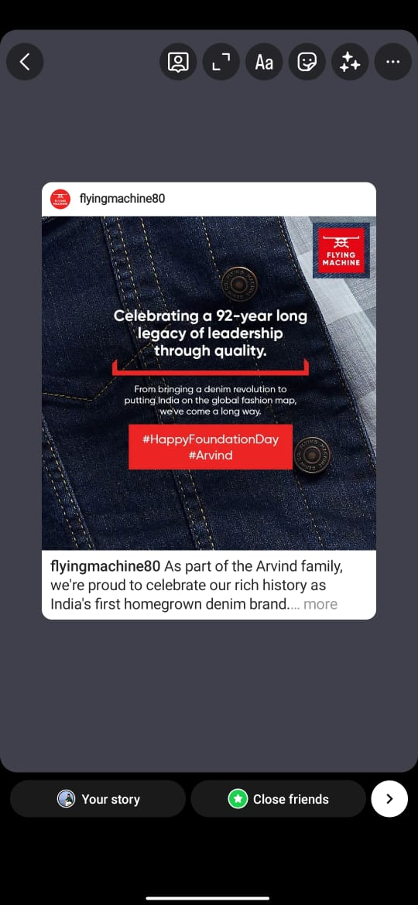
INSTAGRAM STORY:

Slide 25

VIDEO:

Slide 26
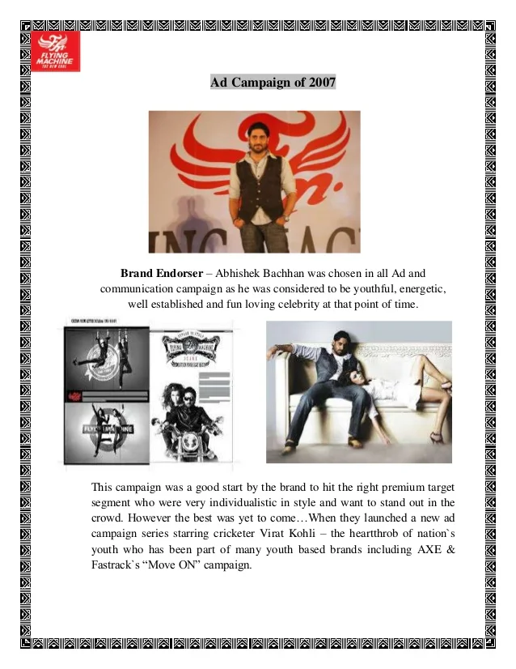
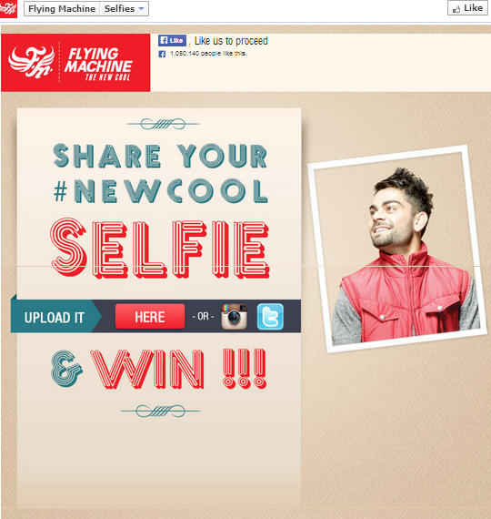
SOCIAL MEDIA AD CAMPAIGN:

Slide 27
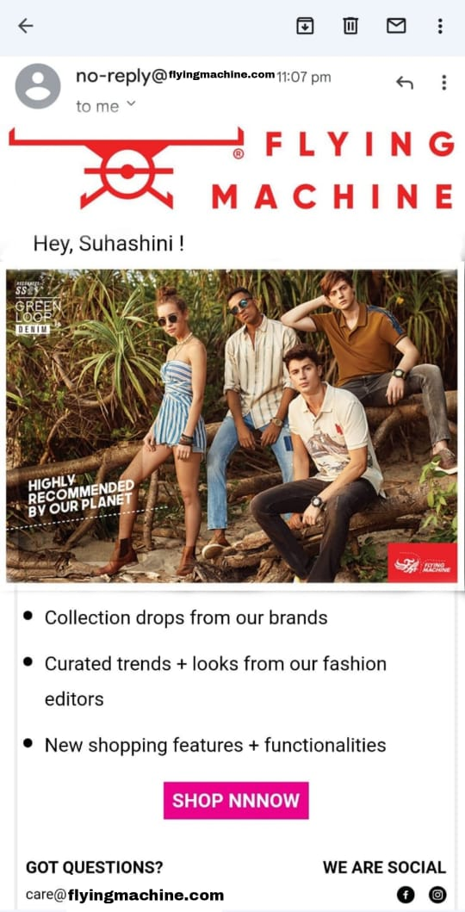
EMAIL CAMPAIGN 1:

Slide 28
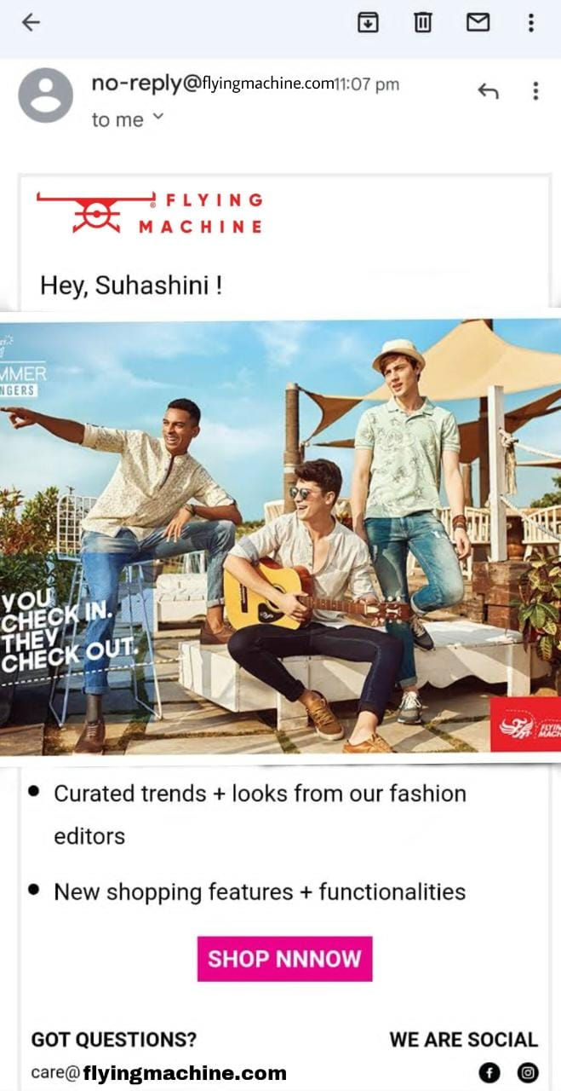
EMAIL CAMPAIGN 2:

Slide 29
Reflect on the content creation and curation process, discussing the challenges faced and lessons learned:
Digital marketing refers to the use of digital channels, platforms, and technologies to promote products, services, or brands to reach and engage with a target audience. It has become a critical component of modern marketing strategies due to the widespread adoption of digital devices and the internet
We have learned many different things from this content such as how to promote the brand and how do campaign through the social media, Instagram stories. Even this is a new content we are able to do our presentation with the help of team work.
It is a great challenge to our team . We have learned many new thinking from this content. It is a one type of experience we have gained. During this, various challenges can arise that may hinder its successful completion. These challenges can vary depending on the nature and scope of the project, as well as the team and resources involved.

Slide 30
THANK YOU

